Slide 1


Depression severity detection based on speech data

Slide 2
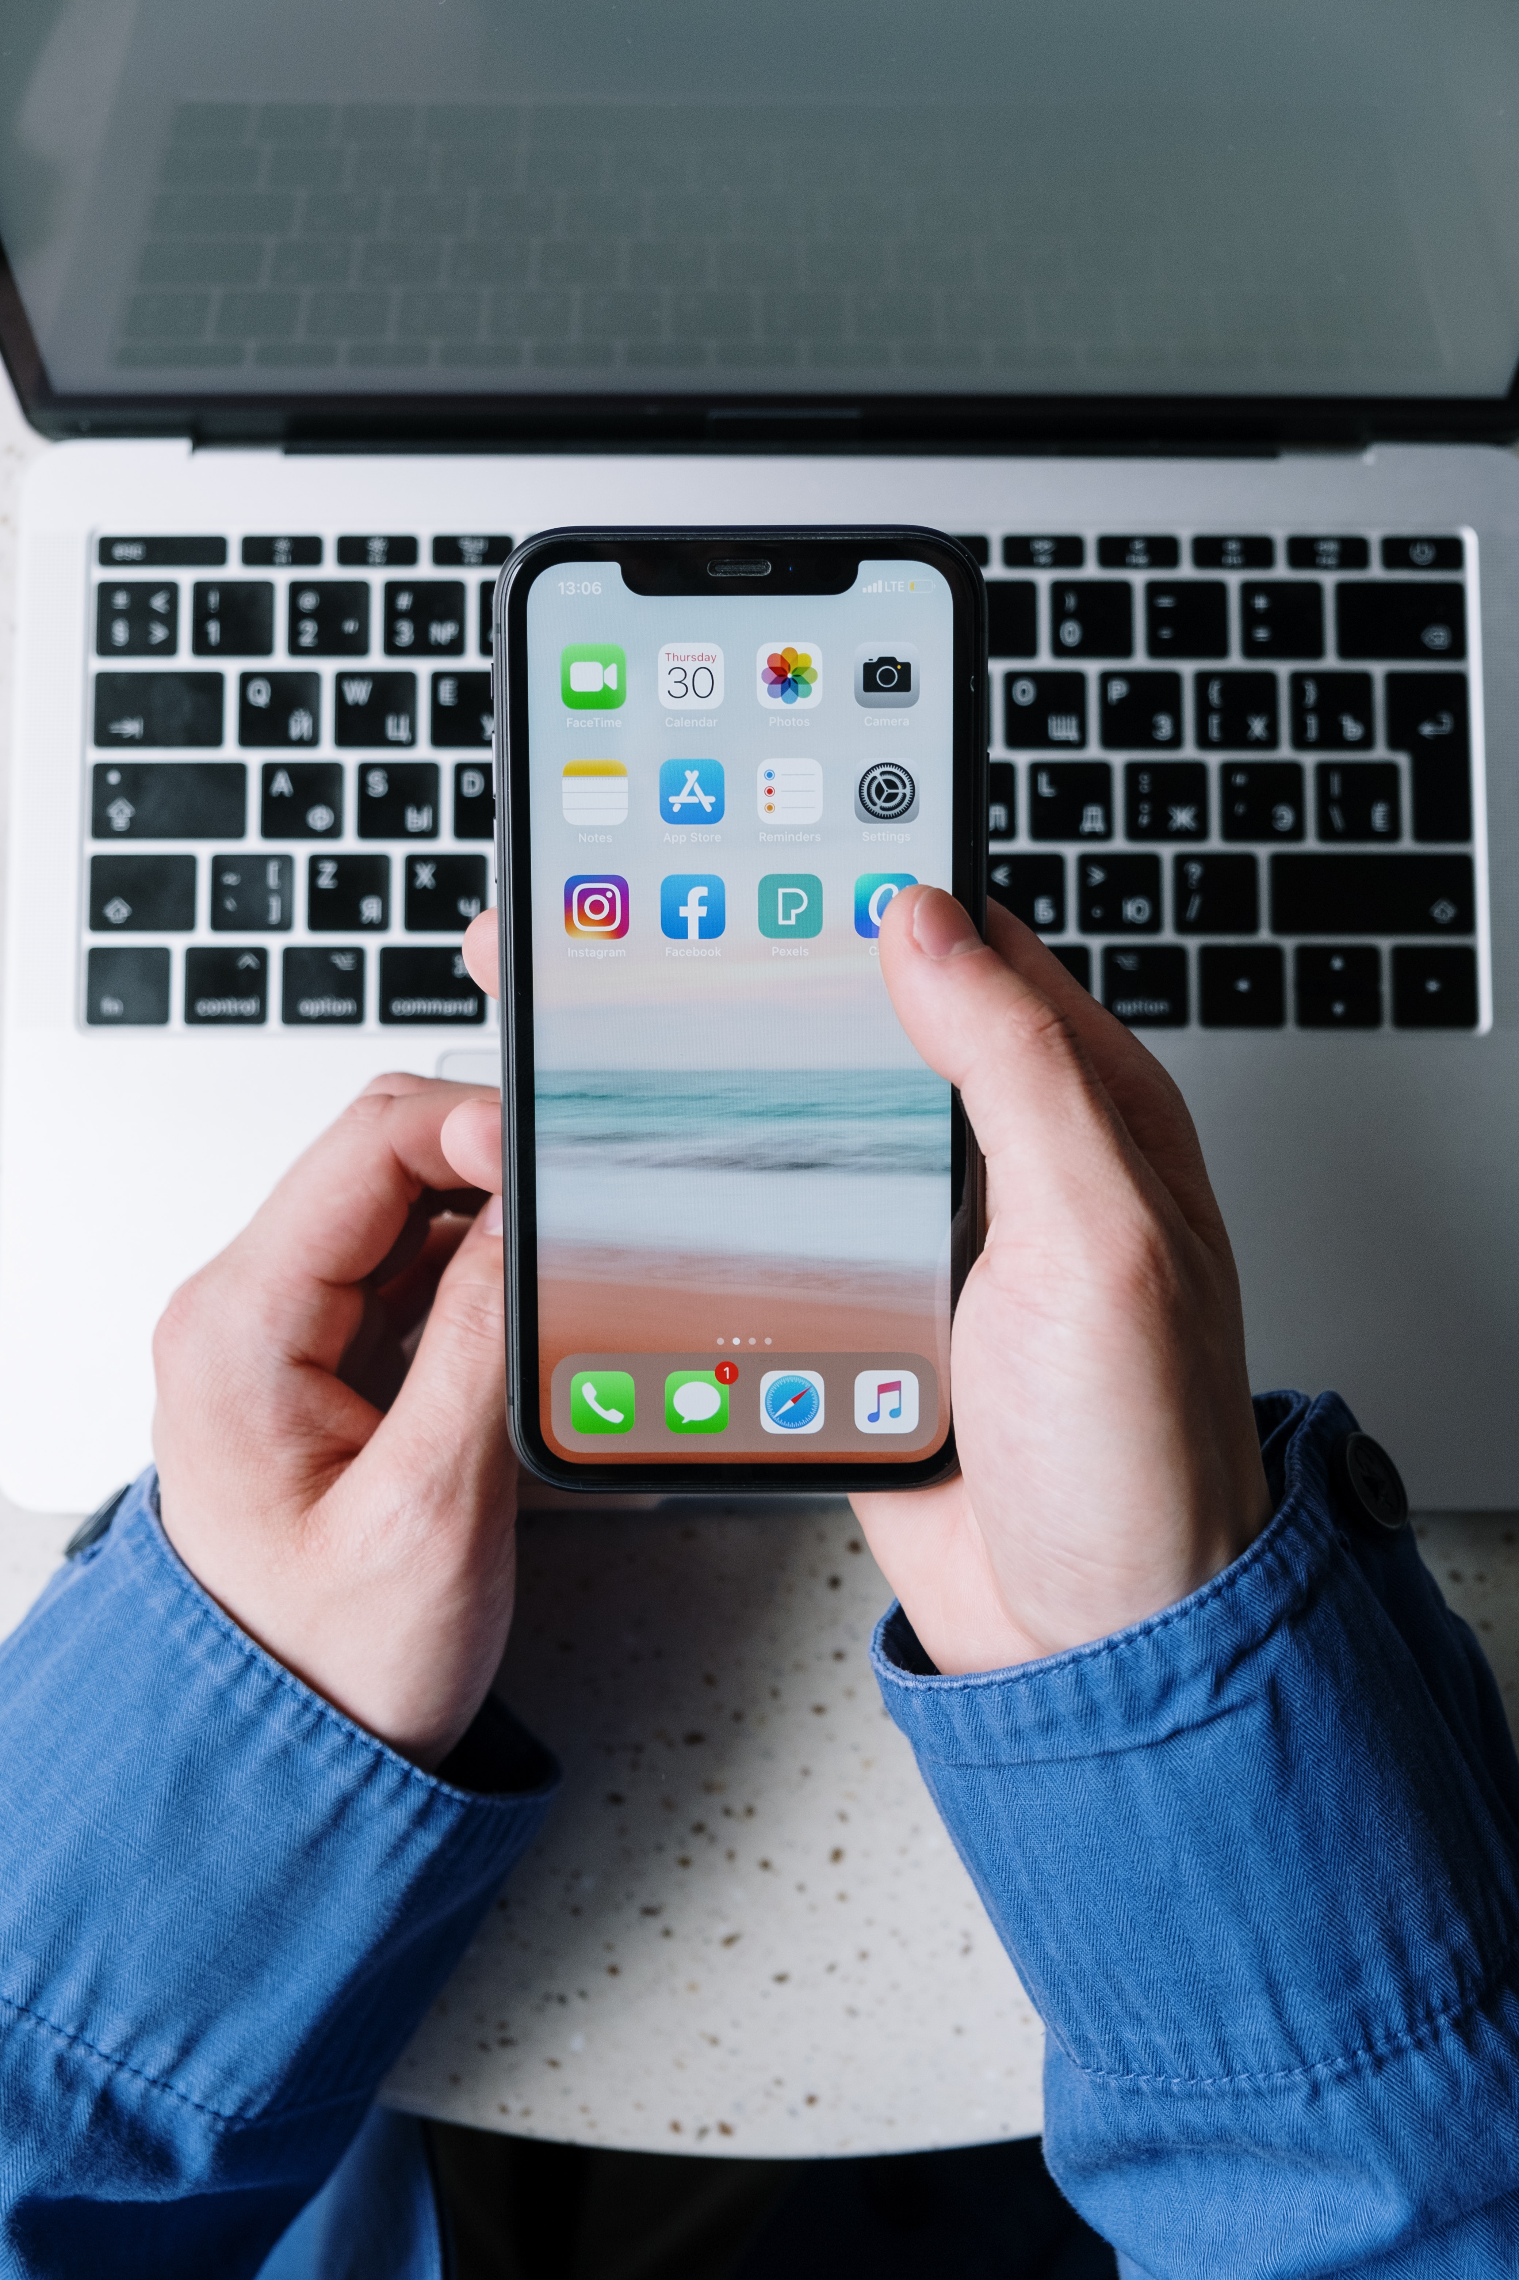
Patient view
The patient opens the depression detection app on his/ her smartphone

Slide 3
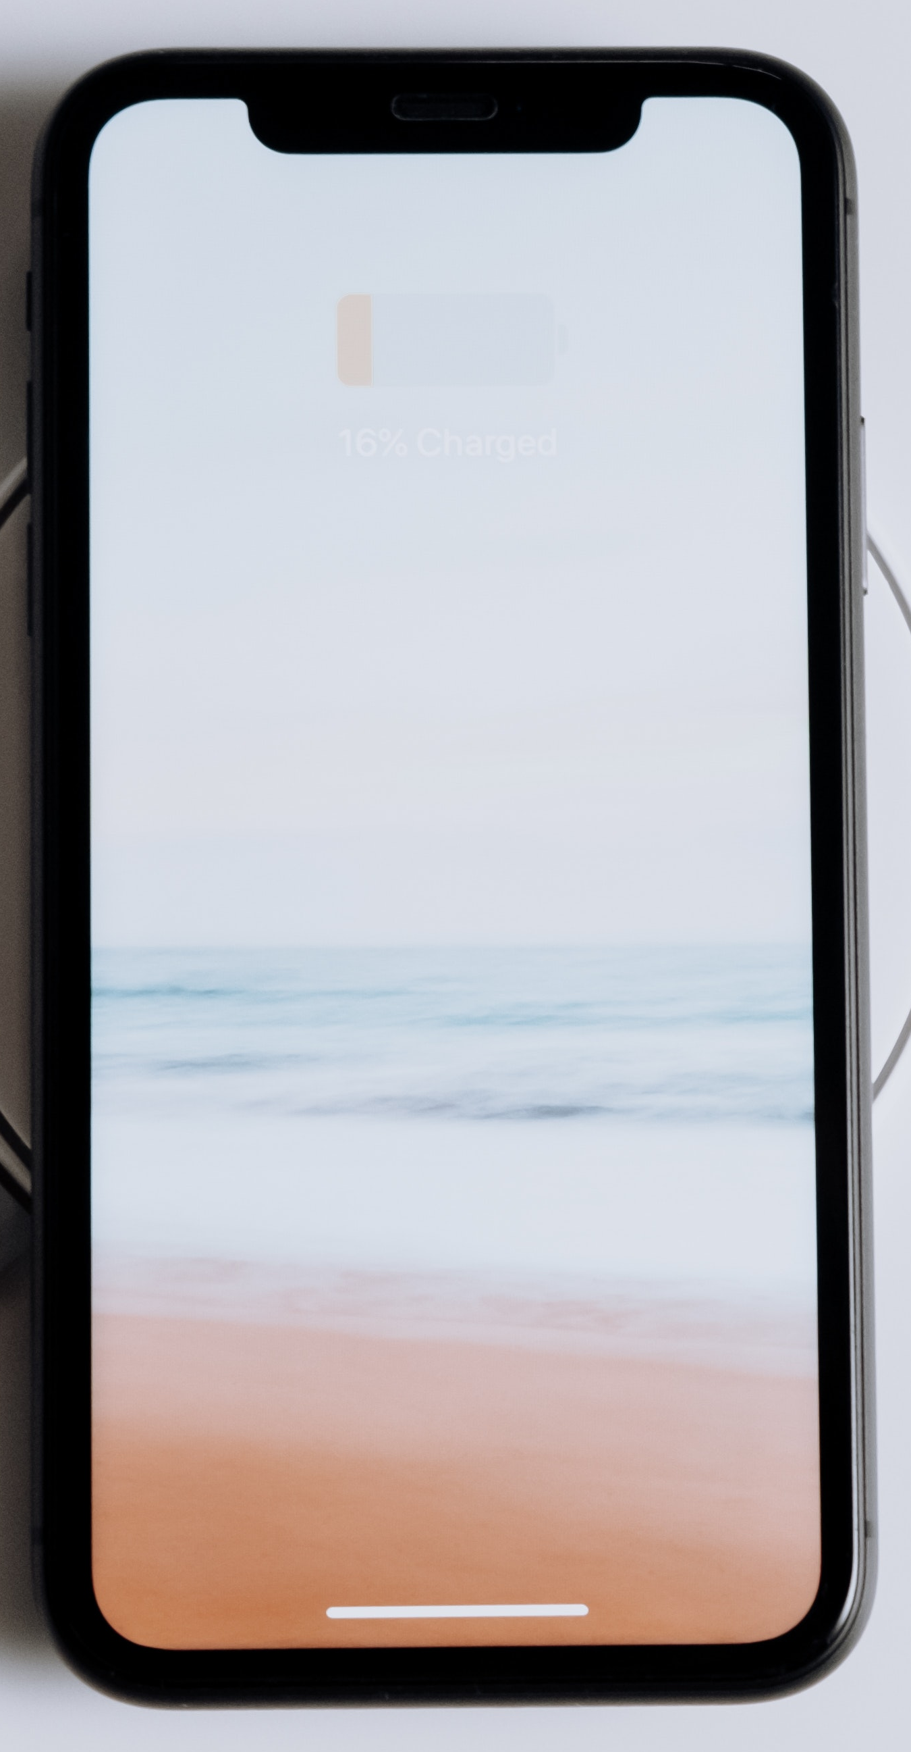

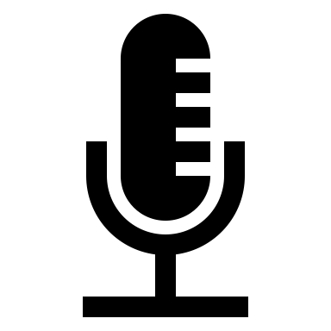
Describe your perfect day
Get a different topic
Remember to find a quiet place for the recording (30 seconds)
Begin recording

Slide 4
Please speak for 30 seconds
How does your perfect day look like?

Slide 5


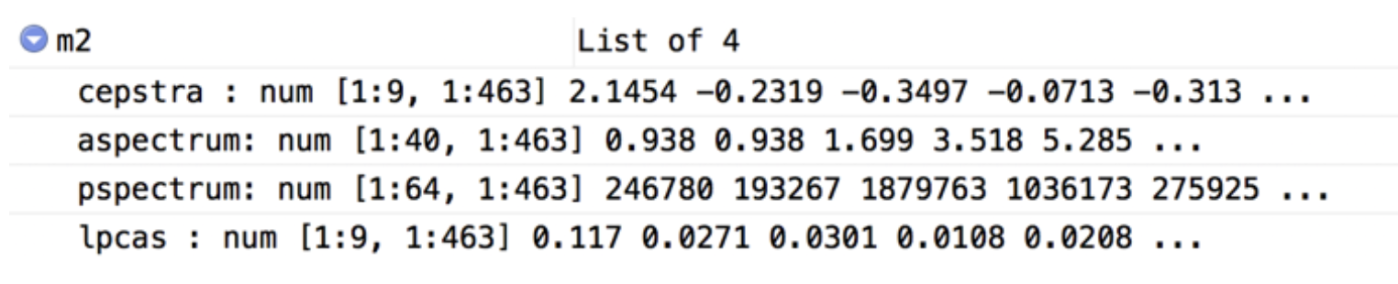
0:00 / 0:30
The voice recording is transformed into data that may be analysed using computer software
Features of the speech data are anaysed to generate a depression severity score
Mood score
65
Good
0
100

Slide 6

Therapist view
Patient A
65
Good
0
100
Depressed mood severity scores
Patient B
15
Bad
0
100

Slide 7
Patient A
If both patients seek treatment and therapy places are limited, patient B would be given preference based on lower mood score.
65
Good
0
100
Patient B
15
Bad
0
100

